Slide 1
Chapter 4
Motion in Two Dimensions
4-1 The Position, Velocity, and Acceleration Vectors
4-2 Two-Dimensional Motion with Constant Acceleration
4-3 Projectile Motion
4-4 Uniform Circular Motion

Slide 2

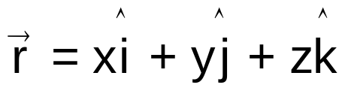

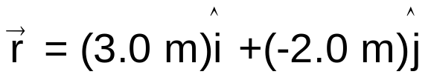
4-1 The Position, Velocity, and Acceleration Vectors
Position vector
The position vector r of a particle is a vector that extends from a reference point to the particle.
y(m)
Usually the reference point is the origin of a coordinate system.
2
1
x(m)
0
1
2
3
4
-1
x is the component of position vector r along the x axis
-2
Particle
The particle has position vector
and rectangle coordinates
(3.0 m, -2.0 m, 0)
The particle has the rectangle coordinates (x, y, z)

Slide 3
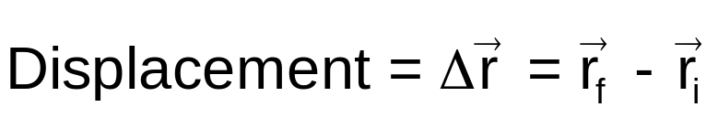

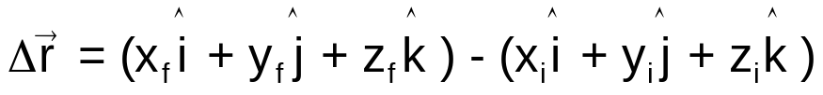

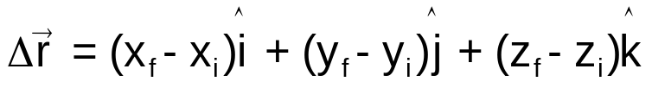

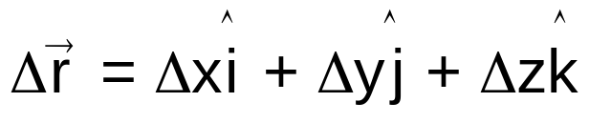
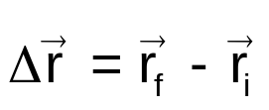
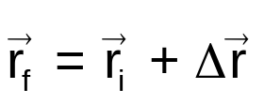
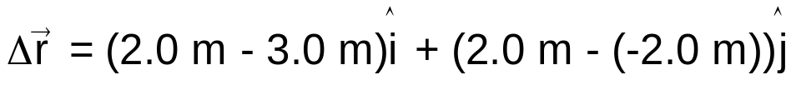
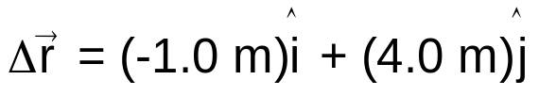
4-1 The Position, Velocity, and Acceleration Vectors
Displacement
The displacement of a particle is the change in its position vector.
y(m)
2
1
x(m)
0
1
2
3
4
-1
-2
Change in the x component of the position vector r

Slide 4
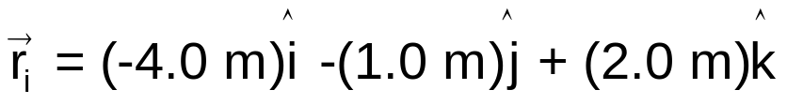
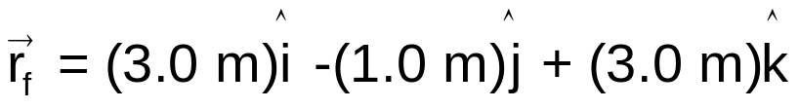
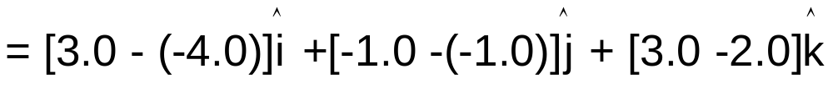
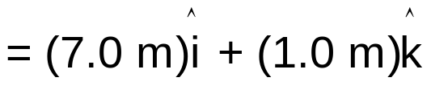
4-1 Position and Displacement
Example 1
The position vector for a particle is initially
and then later is
Solution

Slide 5
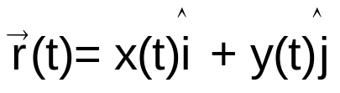
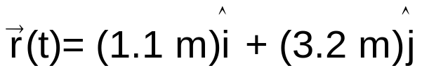

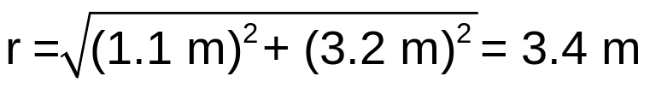
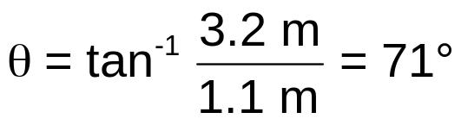
4-1 Position and Displacement
Example 2
A particle is moving in xy plane. The coordinates of its position are given by
x = -0.4 t² + 2.5 t - 1.0 and y = -0.3 t² + 0.5 t + 3.0,
where t in seconds and x and y in meters.
At t = 1 s, what is the particle's position vector in unit-vector notation and in magnitude-angle notation?
Solution
y(m)
4
At t = 1 s,
x = -0.4 (1)² + 2.5 (1) - 1.0 = 1.1 m
y = -0.3 (1)² + 0.5 (1) + 3.0 = 3.2 m
3
2
Unit-vector notation
1
x(m)
Magnitude-angle notation
-2
-1
0
1
2
3
4
-1
-2

Slide 6
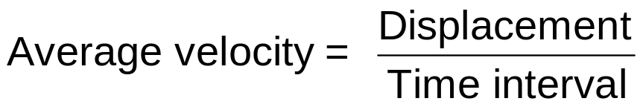
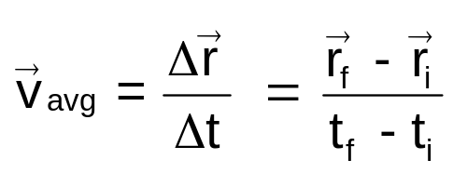
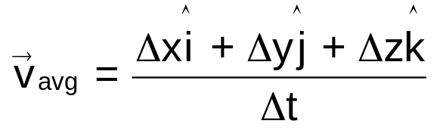

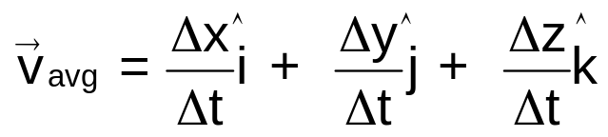

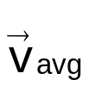
4-1 The Position, Velocity, and Acceleration Vectors
Average velocity
The average velocity v_{avg} of a particle during a time interval is
y
v_{avg} has the same direction as that of Δr.
x

Slide 7
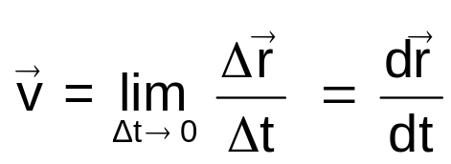




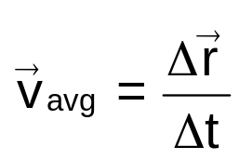
4-1 The Position, Velocity, and Acceleration Vectors
Instantaneous velocity
The velocity of a particle at some instant is
Average velocity
over a time period Δt
Velocity
at an instant t
y
y
Tangent line
x
x
velocity ≡ instantaneous velocity

Slide 8
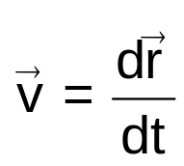
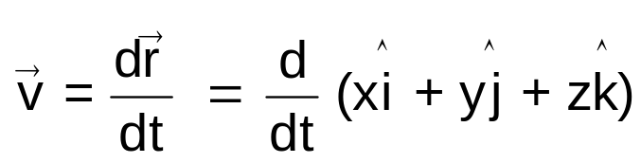
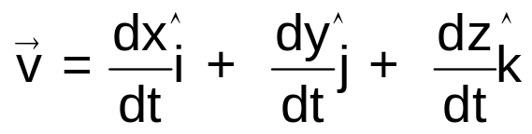
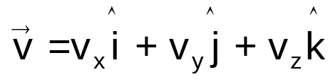
4-1 The Position, Velocity, and Acceleration Vectors
Instantaneous velocity
The velocity of a particle at some instant is
The direction of the instantaneous velocity of a particle is always tangent to the particle's path at the particle's position.
y
Tangent line
the x component of velocity vector v along the x axis
x

Slide 9
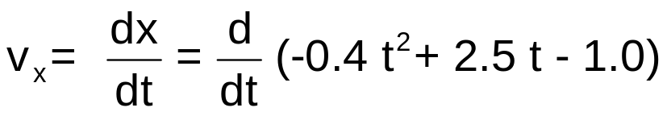
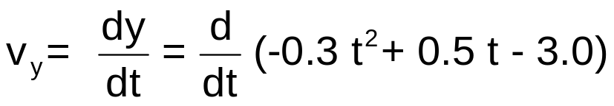

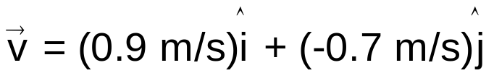
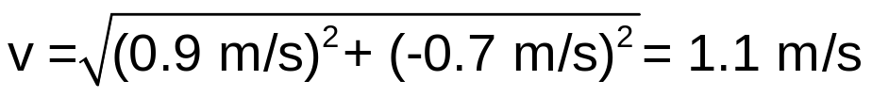
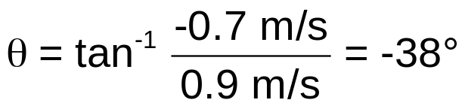
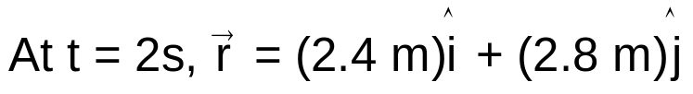
4-1 The Position, Velocity, and Acceleration Vectors
Example 3
A particle is moving in xy plane. The coordinates of its position are given by
x = -0.4 t² + 2.5 t - 1.0 and y = -0.3 t² + 0.5 t + 3.0,
where t in seconds and x and y in meters.
What is the particle's velocity at t = 2 s?
Solution
y(m)
4
3
2
1
x(m)
-2
-1
0
1
2
3
4
-1
-2

Slide 10
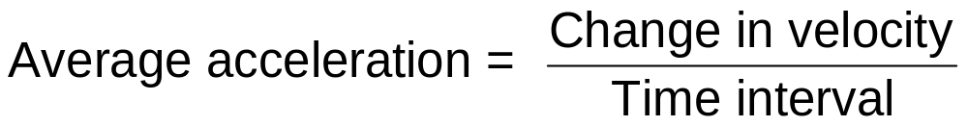
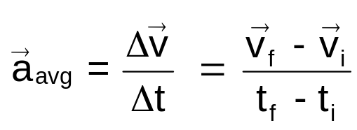



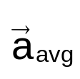
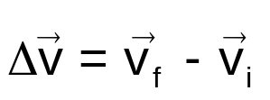
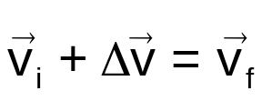
4-1 The Position, Velocity, and Acceleration Vectors
Average acceleration
The average acceleration a_{avg} of a particle during a time interval is
y
a_{avg} has the same direction as that of Δv.
Since multiplying a vector quantity (Δv) by a positive scalar quantity (1/Δt) changes only the magnitude of the vector, not its direction.
x

Slide 11
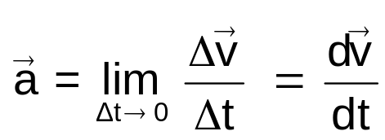
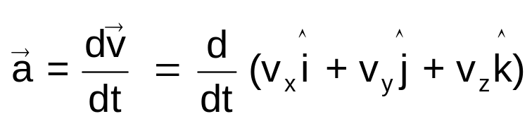
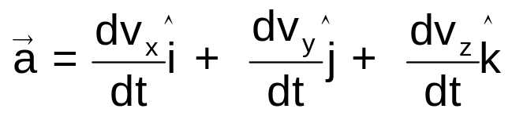
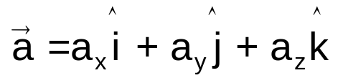

4-1 The Position, Velocity, and Acceleration Vectors
Instantaneous acceleration
The acceleration a of a particle at some instant is
y
the x component of acceleration vector a along the x axis
x

Slide 12
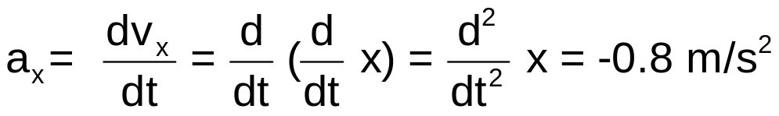
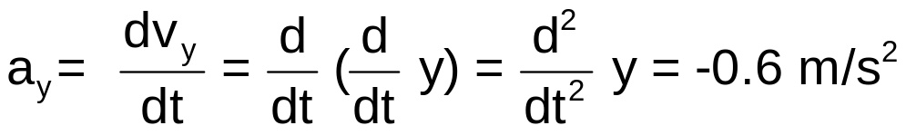

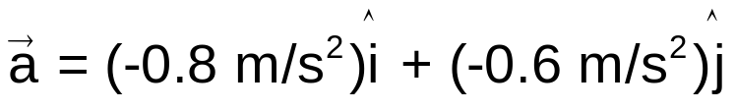


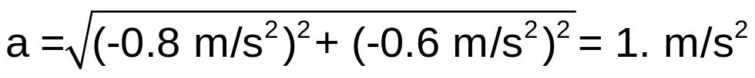

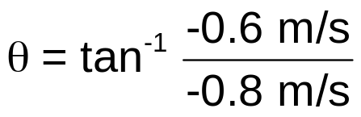


4-1 The Position, Velocity, and Acceleration Vectors
Example 4
A particle is moving in xy plane. The coordinates of its position are given by
x = -0.4 t² + 2.5 t - 1.0 and y = -0.3 t² + 0.5 t + 3.0,
where t in seconds and x and y in meters.
What is the particle's acceleration at t = 2 s?
Solution
y(m)
t = 2 s
4
3
2
1
Using a calculator
x(m)
This angle is not consistent with the directions of the acceleration.
The correct answer is
-2
-1
0
1
2
3
4
-1
-2

Slide 13
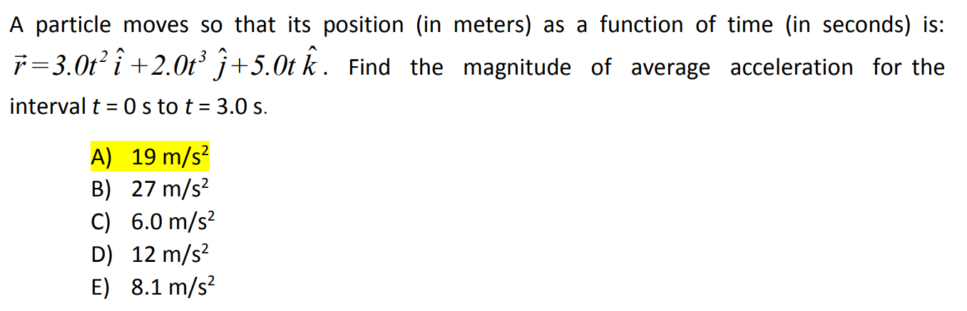


Slide 14




Slide 15



Slide 16






4-2 Two-Dimensional Motion with Constant Acceleration
Motion in two dimensions
Motion in two dimensions is equivalent to
two independent one-dimensional motions:
one in the x direction and one in the y direction.
For constant acceleration,
motion in two dimensions
is equivalent to two independent one-dimensional motions.
motion parallel the x direction
motion parallel the y direction

Slide 17




Slide 18



